Slide 1
Department of Computer Science & Cybersecurity
CHPATER 7. RNN
CS 5720: Neural Network & Deep Learning
Dr. I Hua Tsai, Assistant Professor

Slide 2
Outline
RNN
LSTM

Slide 3
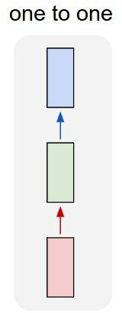
“Vanilla” Neural Network
Vanilla Neural Networks

Slide 4
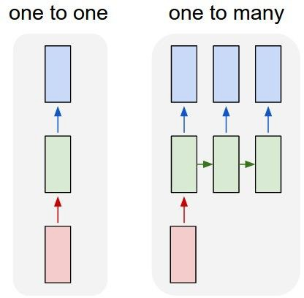
Recurrent Neural Networks: Process Sequences
e.g. Image Captioning
image -> sequence of words

Slide 5
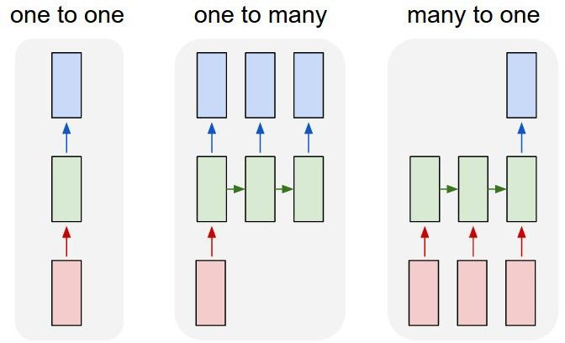
Recurrent Neural Networks: Process Sequences
e.g. action prediction
sequence of video frames -> action class

Slide 6
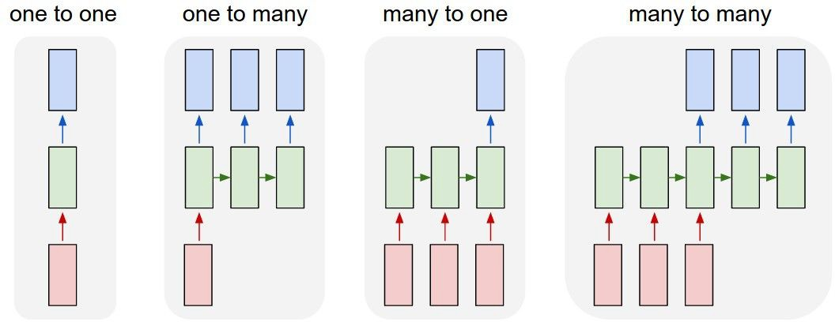
Recurrent Neural Networks: Process Sequences
E.g. Video Captioning
Sequence of video frames -> caption

Slide 7
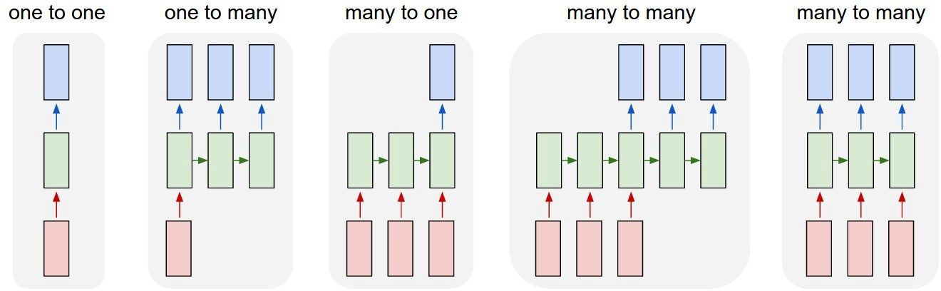
Recurrent Neural Networks: Process Sequences
e.g. Video classification on frame level

Slide 8
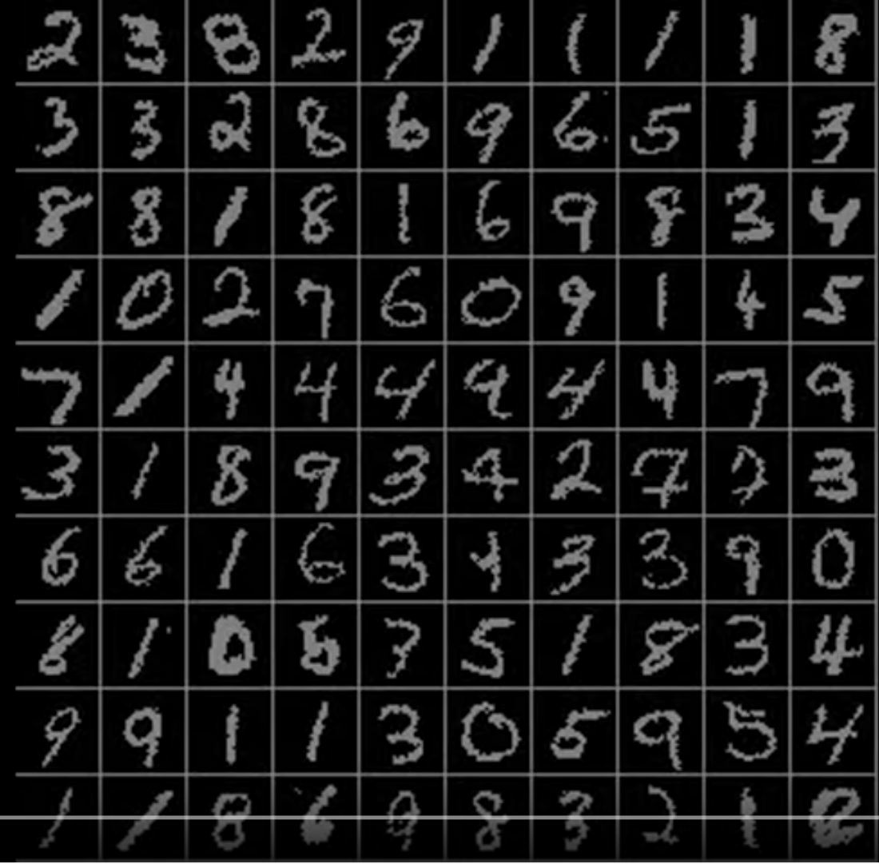
Sequential Processing of Non-Sequence Data
Classify images by taking a series of “glimpses”
Ba, Mnih, and Kavukcuoglu, “Multiple Object Recognition with Visual Attention”, ICLR 2015. Gregor et al, “DRAW: A Recurrent Neural Network For Image Generation”, ICML 2015
Figure copyright Karol Gregor, Ivo Danihelka, Alex Graves, Danilo Jimenez Rezende, and Daan Wierstra, 2015. Reproduced with permission.

Slide 9
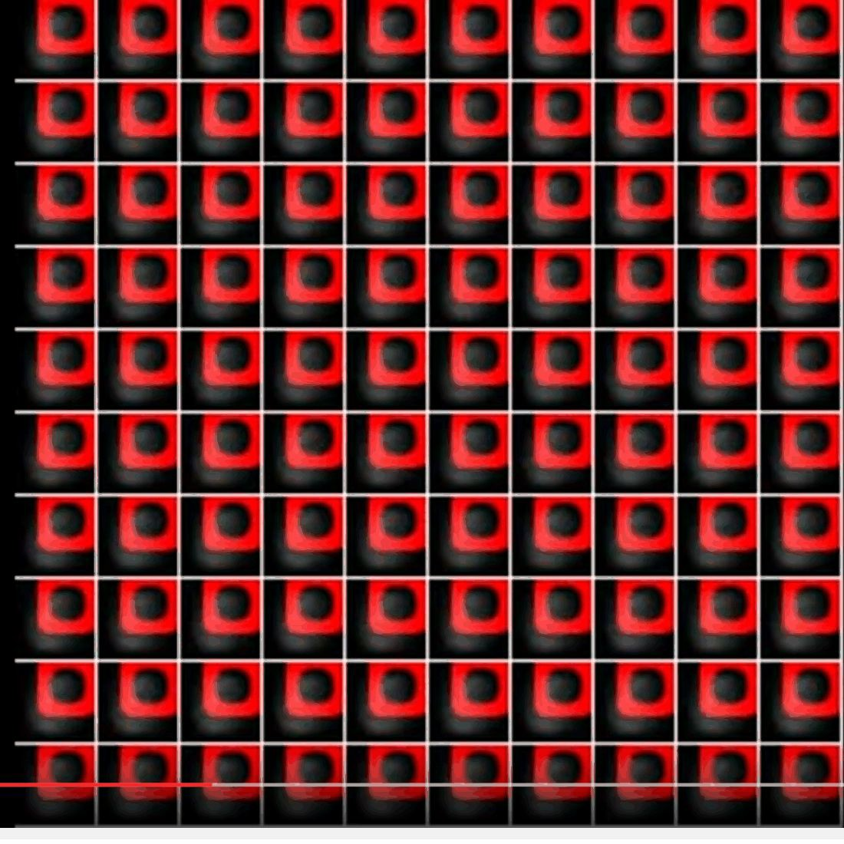
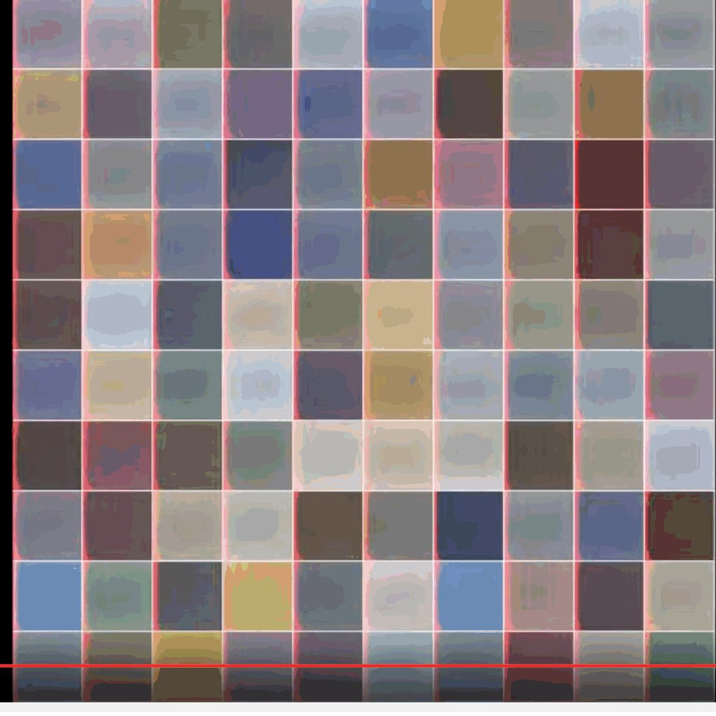
Sequential Processing of Non-Sequence Data
Generate images one piece at a time!
Gregor et al, “DRAW: A Recurrent Neural Network For Image Generation”, ICML 2015
Figure copyright Karol Gregor, Ivo Danihelka, Alex Graves, Danilo Jimenez Rezende, and Daan Wierstra, 2015. Reproduced with permission.

Slide 10
Recurrent Neural Network
y
RNN
x

Slide 11
Recurrent Neural Network
y
Key idea: RNNs have an “internal state” that is updated as a sequence is processed
RNN
x

Slide 12
Unrolled RNN
y₁
y₂
y₃
y_{t}
RNN
RNN
RNN
RNN
...
x₁
x₂
x₃
x_{t}

Slide 13
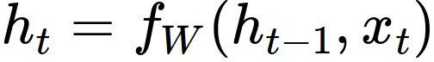
RNN hidden state update
We can process a sequence of vectors x by applying a recurrence formula at every time step:
y
RNN
new state old state input vector at
some time step
x
some function
with parameters W

Slide 14
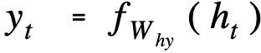
RNN output generation
We can process a sequence of vectors x by applying a recurrence formula at every time step:
y
RNN
output
new state
x
another function with parameters W_{o}

Slide 15
Recurrent Neural Network
y₁
y₂
y₃
y_{t}
h₀
RNN
h₁
RNN
h₂
RNN
h₃
RNN
...
x₁
x₂
x₃
x_{t}

Slide 16
Recurrent Neural Network
We can process a sequence of vectors x by applying a recurrence formula at every time step:
y
RNN
x
Notice: the same function and the same set of parameters are used at every time step.

Slide 17
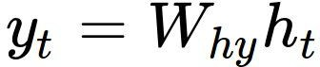
(Vanilla) Recurrent Neural Network
The state consists of a single “hidden” vector h:
y
RNN
x
Sometimes called a “Vanilla RNN” or an “Elman RNN” after Prof. Jeffrey Elman

Slide 18
RNN: Computational Graph
h₀
h₁
f_{W}
x₁

Slide 19
RNN: Computational Graph
h₀
h₁
h₂
f_{W}
f_{W}
x₁
x₂

Slide 20
RNN: Computational Graph
h₀
h₁
h₂
h₃
…
h_{T}
f_{W}
f_{W}
f_{W}
x₁
x₂
x₃

Slide 21
RNN: Computational Graph
Re-use the same weight matrix at every time-step
h₃
…
h_{T}
h₀
f_{W}
h₁
f_{W}
h₂
f_{W}
x₁
x₂
x₃
W

Slide 22
RNN: Computational Graph: Many to Many
y₁
y₂
y₃
y_{T}
h₃
…
h_{T}
h₀
f_{W}
h₁
f_{W}
h₂
f_{W}
x₁
x₂
x₃
W

Slide 23
RNN: Computational Graph: Many to Many
y₁
y₂
y₃
y_{T}
L₁
L₂
L₃
L_{T}
h₃
…
h_{T}
h₀
f_{W}
h₁
f_{W}
h₂
f_{W}
x₁
x₂
x₃
W

Slide 24
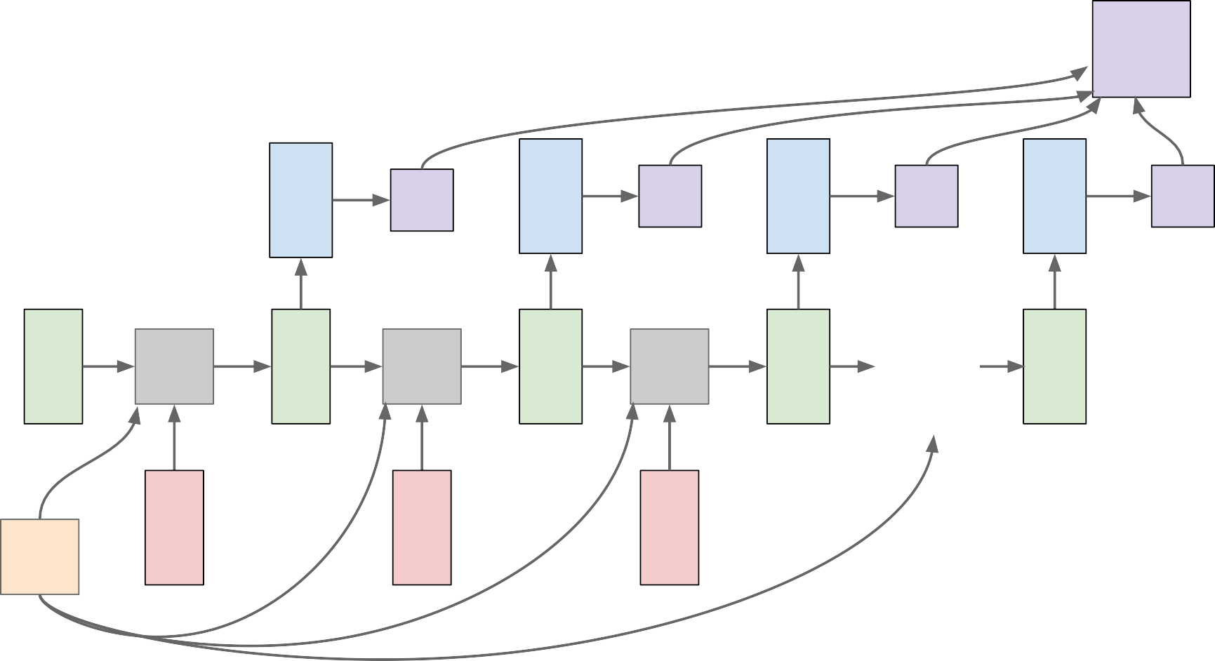
RNN: Computational Graph: Many to Many
L
 | y₁ | L₁ | y₂ | L₂ | y₃ | L₃ | y_{T} | L_{T}
f_{W} x₁ | h₁ | f_{W} x₂ | h₂ | f_{W} x₃ | h₃ | … | h_{T}
h₀
W

Slide 25
RNN: Computational Graph: Many to One
y
h₃
…
h_{T}
h₀
f_{W}
h₁
f_{W}
h₂
f_{W}
x₁
x₂
x₃
W

Slide 26
RNN: Computational Graph: Many to One
y
h₃
…
h_{T}
h₀
f_{W}
h₁
f_{W}
h₂
f_{W}
x₁
x₂
x₃
W

Slide 27
RNN: Computational Graph: One to Many
y₁
y₂
y₃
y_{T}
h₃
…
h_{T}
h₀
f_{W}
h₁
f_{W}
h₂
f_{W}
x
W

Slide 28
RNN: Computational Graph: One to Many
y₁
y₂
y₃
y_{T}
h₃
…
h_{T}
h₀
f_{W}
h₁
f_{W}
h₂
f_{W}
x
?
?
?
W

Slide 29
RNN: Computational Graph: One to Many
y₁
y₂
y₃
y_{T}
h₃
…
h_{T}
h₀
f_{W}
h₁
f_{W}
h₂
f_{W}
x
0
0
0
W

Slide 30
RNN: Computational Graph: One to Many
y₁
y₂
y₃
y_{T}
h₃
…
h_{T}
h₀
f_{W}
h₁
f_{W}
h₂
f_{W}
x
y₁
y₂
y
W
T-1

Slide 31
Sequence to Sequence: Many-to-one + one-to-many
Many to one: Encode input sequence in a single vector
h₀
h₁
h₂
h₃
…
h_{T}
f_{W}
f_{W}
f_{W}
x₁
x₂
x₃
W₁
Sutskever et al, “Sequence to Sequence Learning with Neural Networks”, NIPS 2014

Slide 32
Sequence to Sequence: Many-to-one + one-to-many
One to many: Produce output sequence from single input vector
Many to one: Encode input
sequence in a single vector
y₁
y₂
h₀
h₁
h₂
h₃
…
h_{T}
h₁
h₂
…
f_{W}
f_{W}
f_{W}
f_{W}
f_{W}
f_{W}
x₁
x₂
x₃
W₁
W₂
Sutskever et al, “Sequence to Sequence Learning with Neural Networks”, NIPS 2014

Slide 33
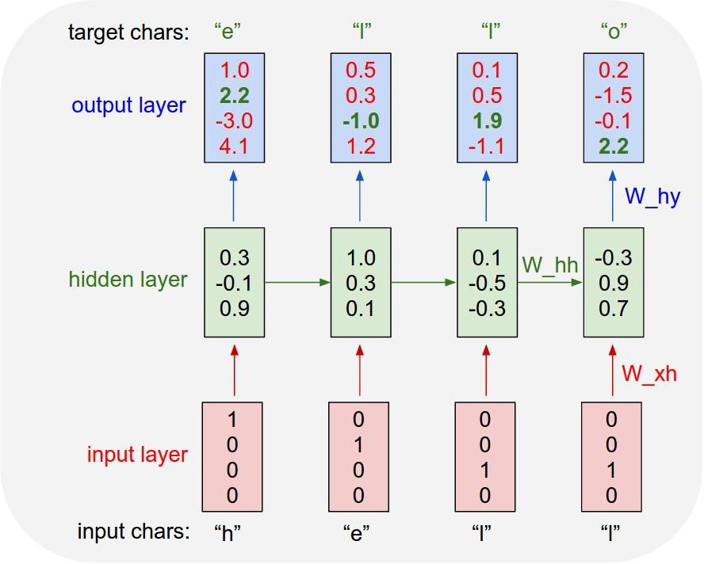
Example: Character-level Language Model
Vocabulary: [h,e,l,o]
Example training sequence: “hello”

Slide 34
Example: Character-level Language Model
Vocabulary: [h,e,l,o]
Example training sequence: “hello”

Slide 35
Example: Character-level Language Model
Vocabulary: [h,e,l,o]
Example training sequence: “hello”

Slide 36
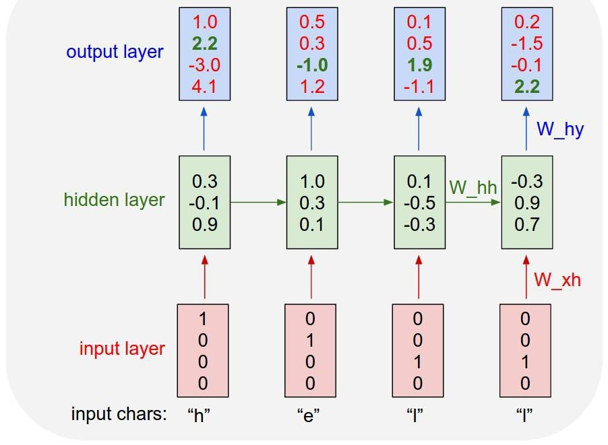
Example: Character-level Language Model Sampling
“e”
“l”
.25
.20
.05
.50
“l” “o”
.11 .11
.17 .02
.68 .08
.03 .79
Sample
.03
.84
.00
.13
Softmax
Vocabulary:
[h,e,l,o]
At test-time sample characters one at a time, feed back to model

Slide 37
Example: Character-level Language Model Sampling
“e”
“l”
.25
.20
.05
.50
“l” “o”
.11 .11
.17 .02
.68 .08
.03 .79
Sample
.03
.84
.00
.13
Softmax
Vocabulary:
[h,e,l,o]
At test-time sample characters one at a time, feed back to model

Slide 38
Example: Character-level Language Model Sampling
“e”
“l”
“l” “o”
.11 .11
.17 .02
.68 .08
.03 .79
Sample
.03
.84
.00
.13
.25
.20
.50
.05
Softmax
Vocabulary:
[h,e,l,o]
At test-time sample characters one at a time, feed back to model

Slide 39
Example: Character-level Language Model Sampling
“e” |  | “l” |  | “l” |  | “o”
.03 |  | .25 |  | .11 |  | .11
.84 |  | .20 |  | .17 |  | .02
.00 |  | .50 |  | .68 |  | .08
.13 |  | .05 |  | .03 |  | .79
Sample
Softmax
Vocabulary:
[h,e,l,o]
At test-time sample characters one at a time, feed back to model

Slide 40
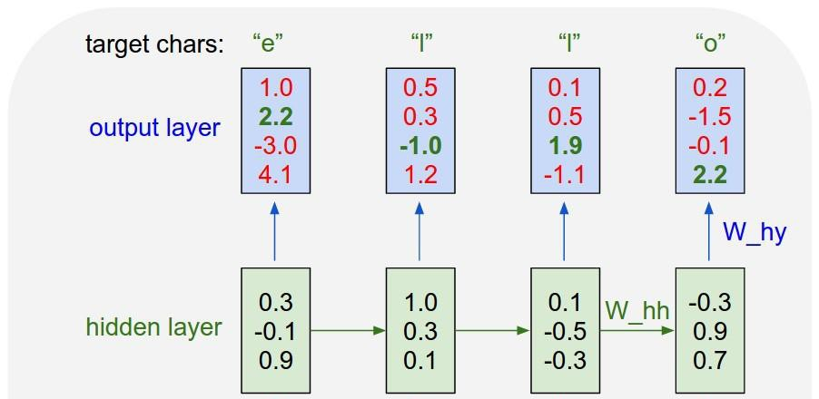
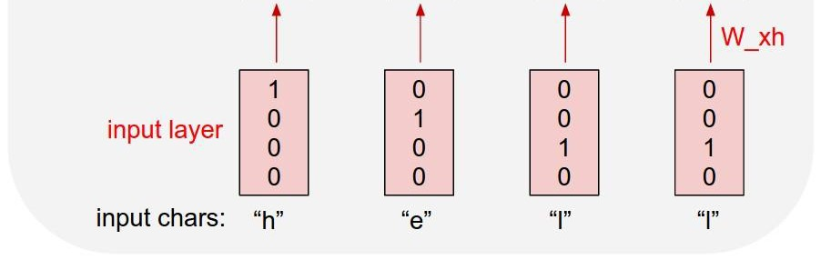
Example: Character-level Language Model Sampling
[w₁₁ w₁₂ w₁₃ w₁₄] [1] [w₁₁] [w₂₁ w₂₂ w₂₃ w₁₄] [0] = [w₂₁]
[w₃₁ w₃₂ w₃₃ w₁₄] [0] [w₃₁]
[0]
.03
.13
.00
.84
.25
.20
.05
.50
.11
.17
.68
.03
.11
.17
.68
.03
Embedding
layer
Matrix multiply with a one-hot vector just extracts a column from the weight matrix. We often put a separate embedding layer between input and hidden layers.

Slide 41


Backpropagation through time
Forward through entire sequence to compute loss, then backward through entire sequence to compute gradient
Loss

Slide 42
Truncated Backpropagation through time
Loss
Run forward and backward through chunks of the sequence instead of whole sequence

Slide 43
Truncated Backpropagation through time
Loss
Carry hidden states forward in time forever, but only backpropagate for some smaller number of steps

Slide 44
Truncated Backpropagation through time
Loss

Slide 45
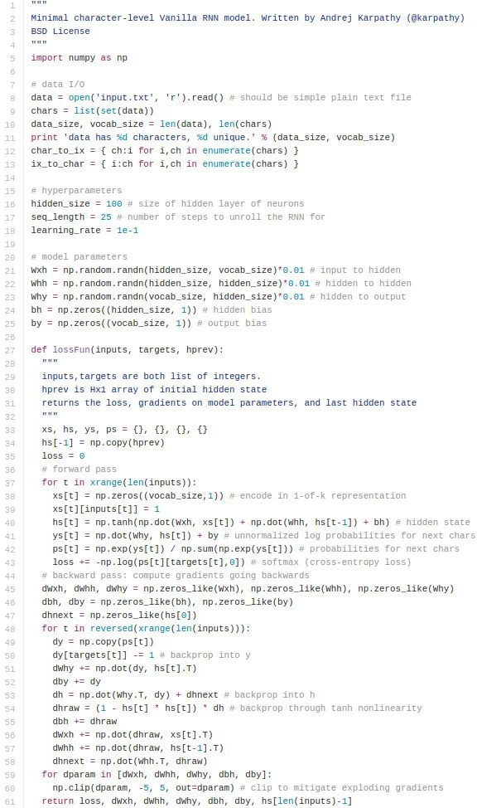
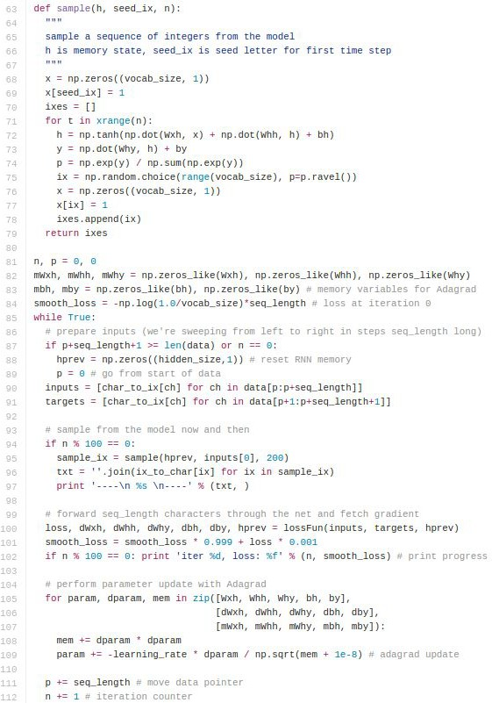
min-char-rnn.py gist
(https://gist.github.com/karpathy/d4dee 566867f8291f086)

Slide 46
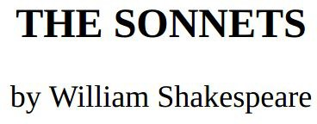
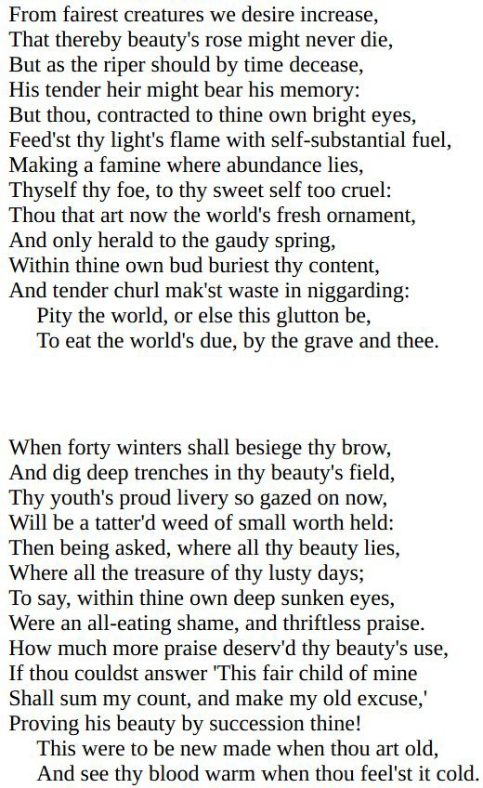
y
RNN
x

Slide 47
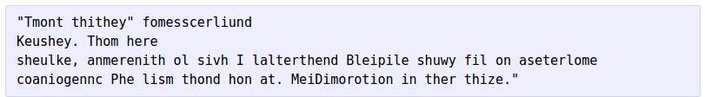
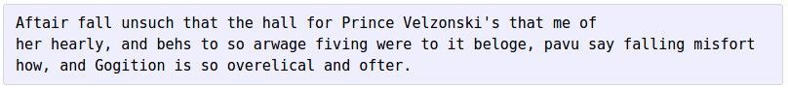
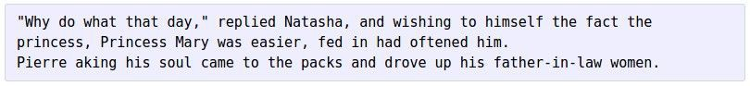
at first:
train more
train more
train more

Slide 48

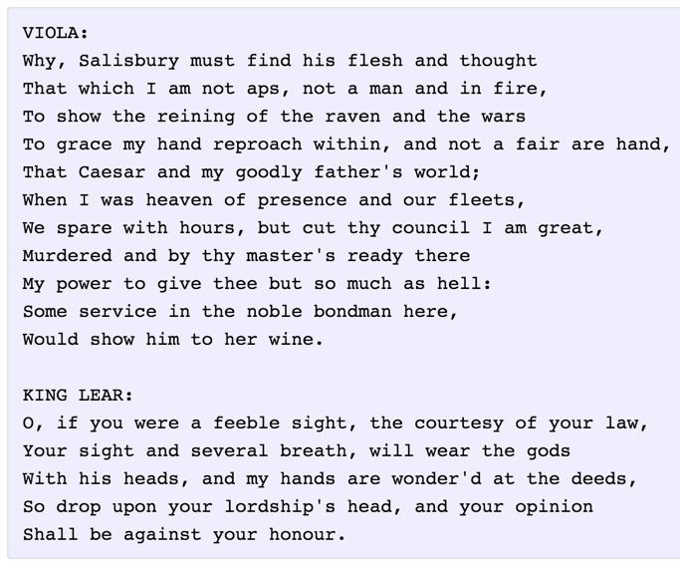

Slide 49
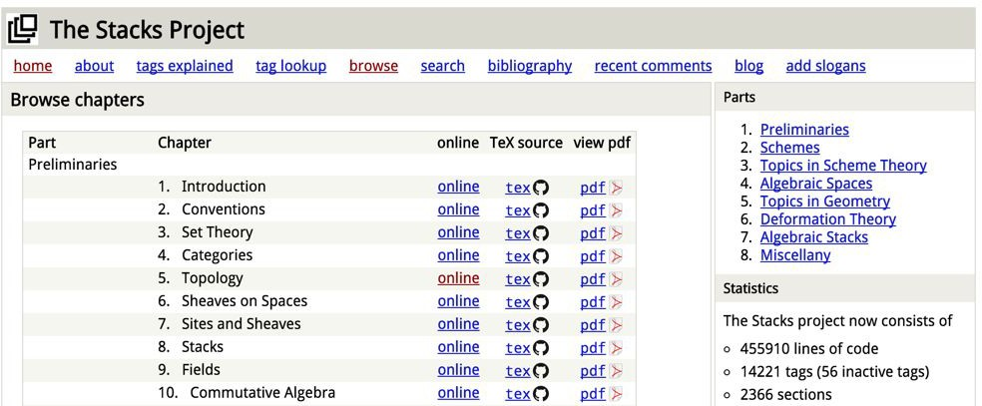
The Stacks Project: open source algebraic geometry textbook
Latex source
http://stacks.math.columbia.edu/
The stacks project is licensed under the GNU Free Documentation License

Slide 50
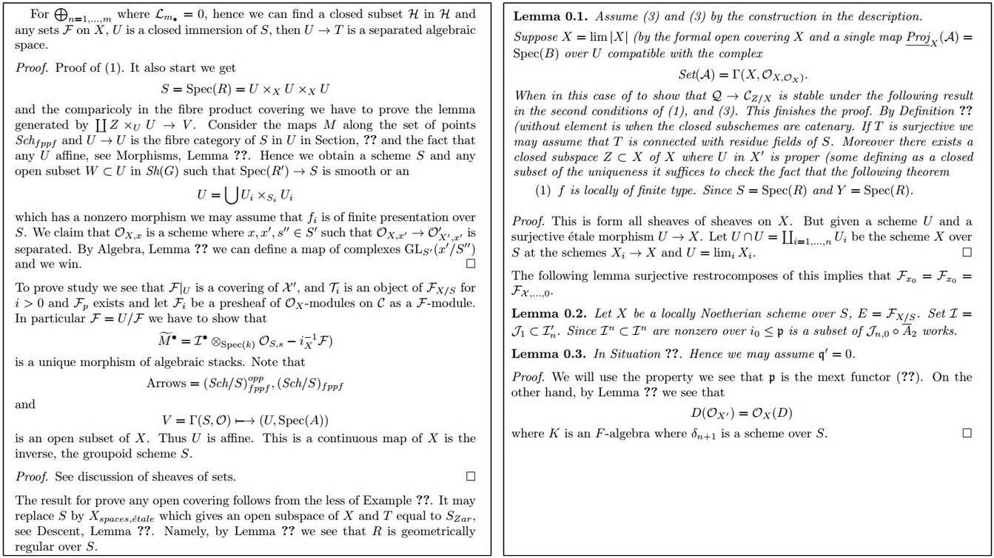

Slide 51
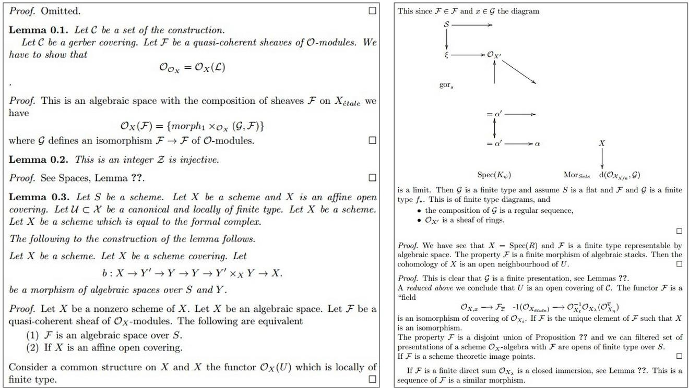

Slide 52
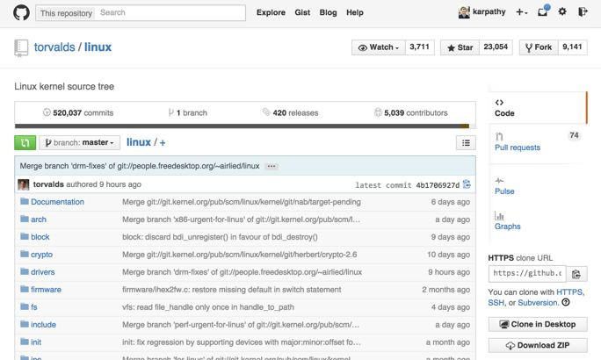

Slide 53

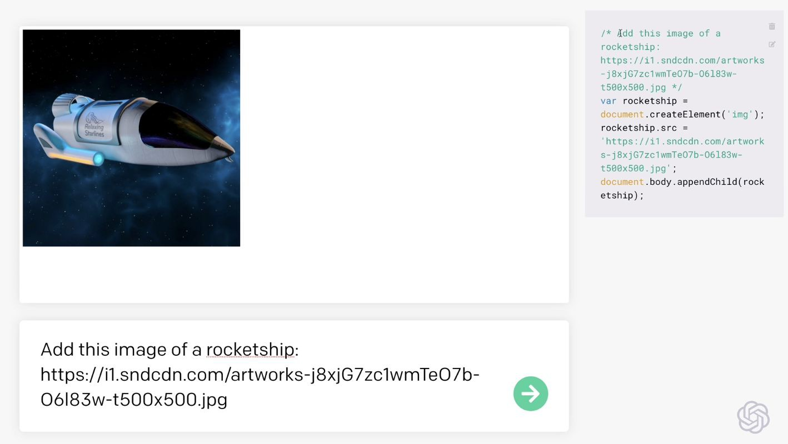
https://openai.com/blog/openai-codex/

Slide 54
OpenAI GPT-2 generated text
source
Input: In a shocking finding, scientist discovered a herd of unicorns living in a remote, previously unexplored valley, in the Andes Mountains. Even more surprising to the researchers was the fact that the unicorns spoke perfect English.
Output: The scientist named the population, after their distinctive horn, Ovid’s Unicorn. These four-horned, silver-white unicorns were previously unknown to science.
Now, after almost two centuries, the mystery of what sparked this odd phenomenon is finally solved.
Dr. Jorge Pérez, an evolutionary biologist from the University of La Paz, and several companions, were exploring the Andes Mountains when they found a small valley, with no other animals or humans. Pérez noticed that the valley had what appeared to be a natural fountain, surrounded by two peaks of rock and silver snow.

Slide 55
Searching for interpretable cells

Slide 56
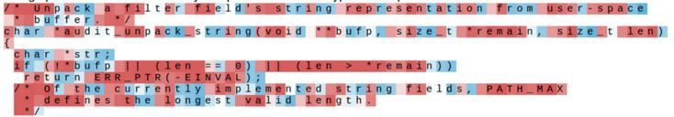
Searching for interpretable cells
Karpathy, Johnson, and Fei-Fei: Visualizing and Understanding Recurrent Networks, ICLR Workshop 2016 Figures copyright Karpathy, Johnson, and Fei-Fei, 2015; reproduced with permission

Slide 57
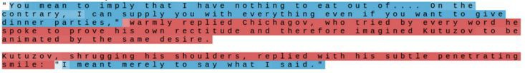
Searching for interpretable cells
quote detection cell
Karpathy, Johnson, and Fei-Fei: Visualizing and Understanding Recurrent Networks, ICLR Workshop 2016 Figures copyright Karpathy, Johnson, and Fei-Fei, 2015; reproduced with permission

Slide 58
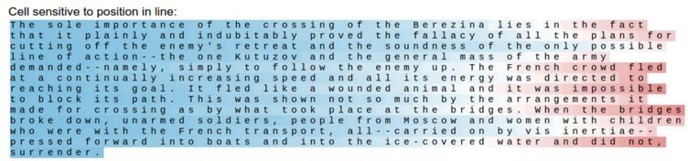
Searching for interpretable cells
line length tracking cell
Karpathy, Johnson, and Fei-Fei: Visualizing and Understanding Recurrent Networks, ICLR Workshop 2016 Figures copyright Karpathy, Johnson, and Fei-Fei, 2015; reproduced with permission

Slide 59
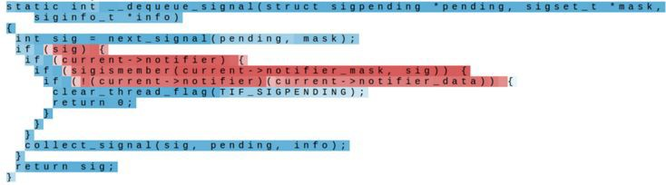
Searching for interpretable cells
if statement cell
Karpathy, Johnson, and Fei-Fei: Visualizing and Understanding Recurrent Networks, ICLR Workshop 2016 Figures copyright Karpathy, Johnson, and Fei-Fei, 2015; reproduced with permission

Slide 60
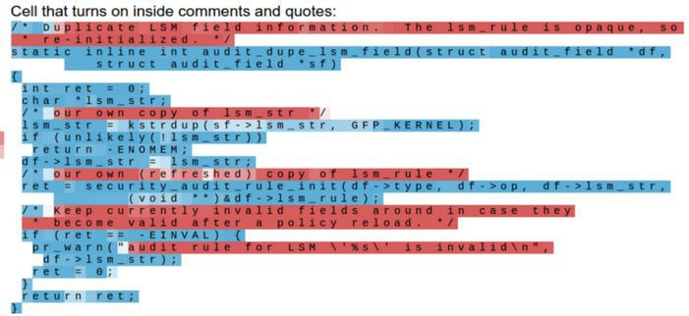
Searching for interpretable cells
quote/comment cell
Karpathy, Johnson, and Fei-Fei: Visualizing and Understanding Recurrent Networks, ICLR Workshop 2016
Figures copyright Karpathy, Johnson, and Fei-Fei, 2015; reproduced with permission

Slide 61
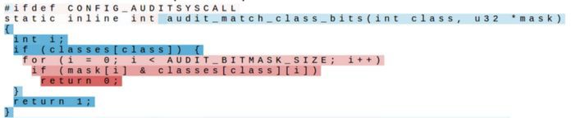
Searching for interpretable cells
code depth cell
Karpathy, Johnson, and Fei-Fei: Visualizing and Understanding Recurrent Networks, ICLR Workshop 2016 Figures copyright Karpathy, Johnson, and Fei-Fei, 2015; reproduced with permission

Slide 62
RNN tradeoffs
RNN Advantages:
Can process any length input
Computation for step t can (in theory) use information from many steps back
Model size doesn’t increase for longer input
Same weights applied on every timestep, so there is symmetry in how inputs are processed.
RNN Disadvantages:
Recurrent computation is slow
In practice, difficult to access information from many steps back

Slide 63
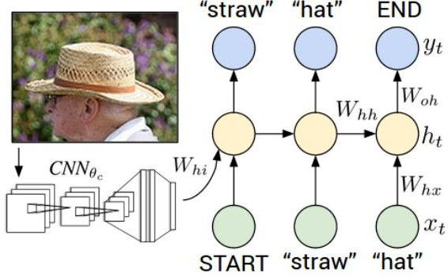
Image Captioning
Figure from Karpathy et a, “Deep
Visual-Semantic Alignments for Generating Image Descriptions”, CVPR 2015; figure copyright IEEE, 2015.
Reproduced for educational purposes.
Explain Images with Multimodal Recurrent Neural Networks, Mao et al.
Deep Visual-Semantic Alignments for Generating Image Descriptions, Karpathy and Fei-Fei Show and Tell: A Neural Image Caption Generator, Vinyals et al.
Long-term Recurrent Convolutional Networks for Visual Recognition and Description, Donahue et al. Learning a Recurrent Visual Representation for Image Caption Generation, Chen and Zitnick

Slide 64
Recurrent Neural Network
Convolutional Neural Network

Slide 65

test image
This image is CC0 public domain

Slide 66
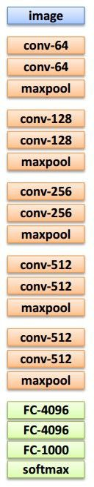
test image

Slide 67
test image
X

Slide 68
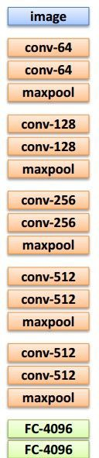
test image
x0
<START>

Slide 69
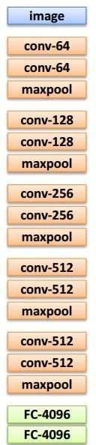

before:
test image
y0
h0
h = tanh(W_{xh} * x + W_{hh} * h)
Wih
now:
h = tanh(W_{xh} * x + W_{hh} * h + W_{ih} * v)
x0
<START>

Slide 70

test image
y0
h0
sample!
x0
<START>
straw

Slide 71
test image
y0
y1
h0
h1
x0
<START>
straw

Slide 72

test image
y0
y1
h0
h1
sample!
x0
<START>
straw
hat

Slide 73
test image
y0
y1
y2
h0
h1
h2
x0
<START>
straw
hat

Slide 74
test image
y0
y1
y2
sample
<END> token
=> finish.
h0
h1
h2
x0
<START>
straw
hat

Slide 75


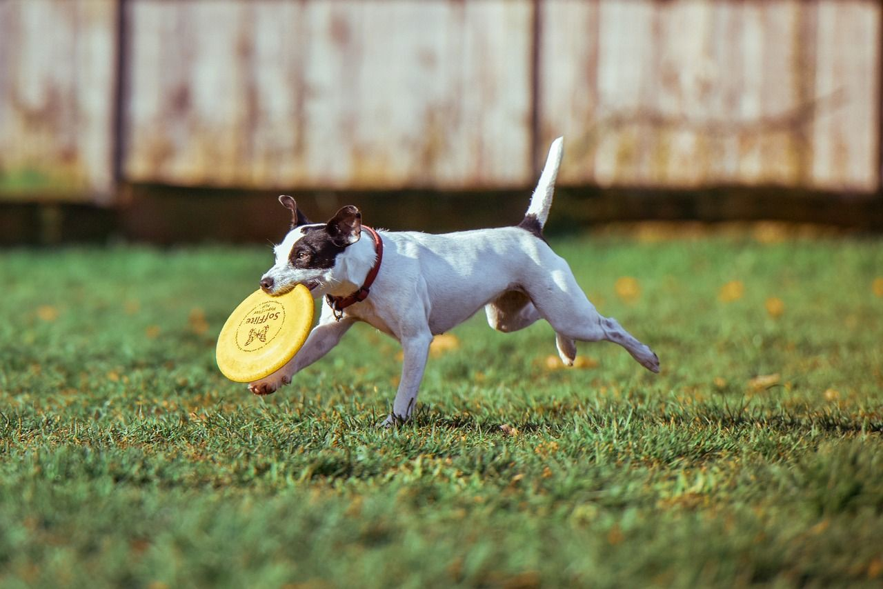


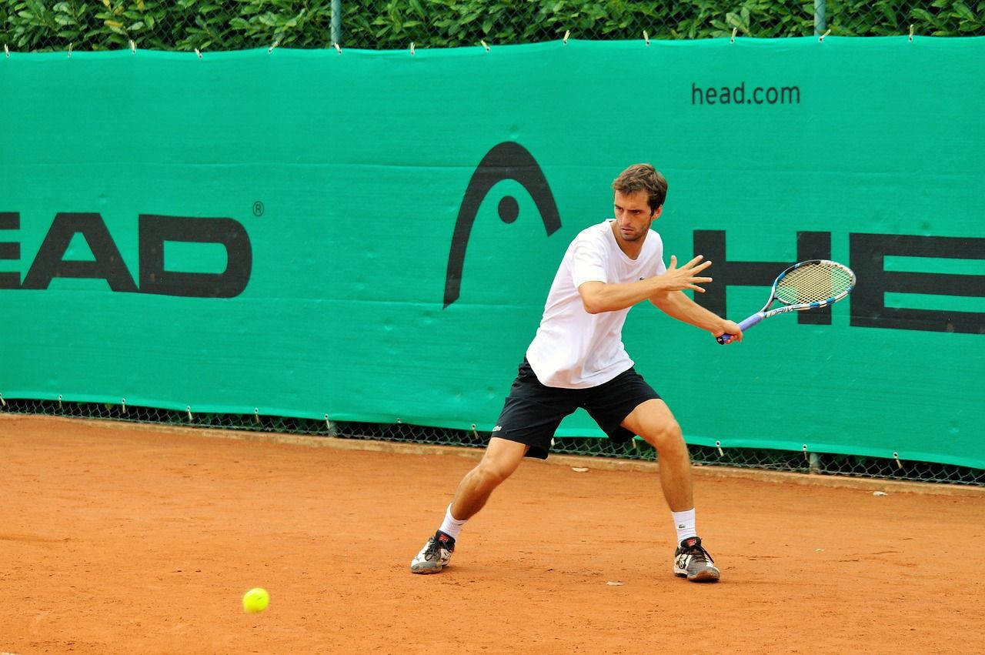
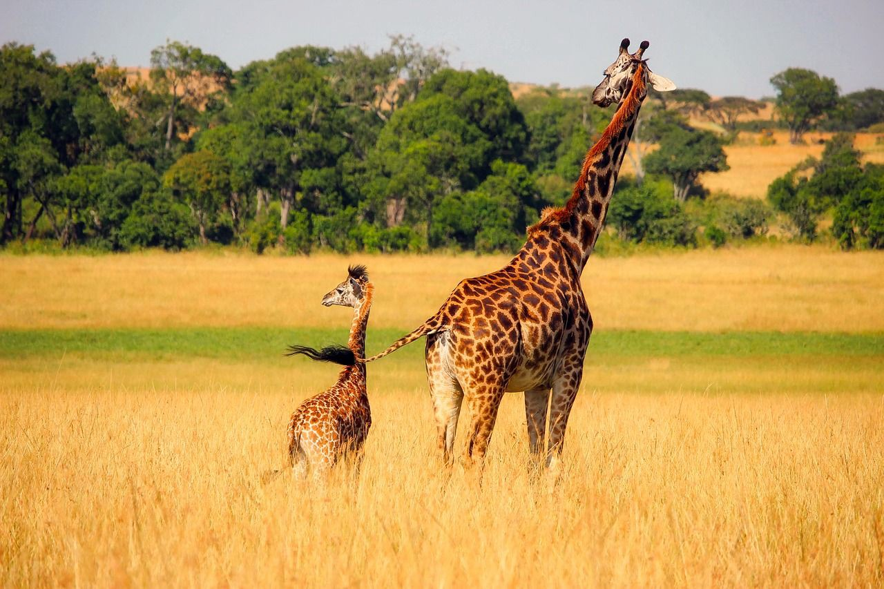
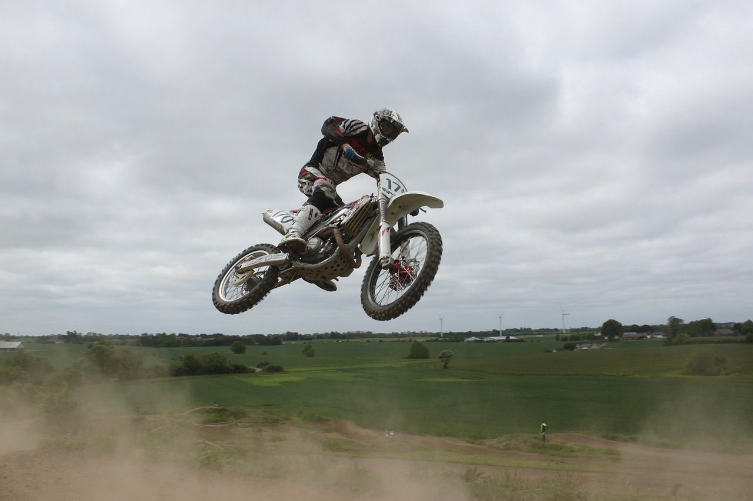
Image Captioning: Example Results
Captions generated using neuraltalk2 All images are CC0 Public domain: cat suitcase, cat tree, dog, bear, surfers, tennis, giraffe, motorcycle
A cat sitting on a suitcase on the floor
A cat is sitting on a tree branch
A dog is running in the grass with a frisbee
A white teddy bear sitting in the grass
Two people walking on the beach with surfboards
A tennis player in action on the court
Two giraffes standing in a grassy field
A man riding a dirt bike on a dirt track

Slide 76

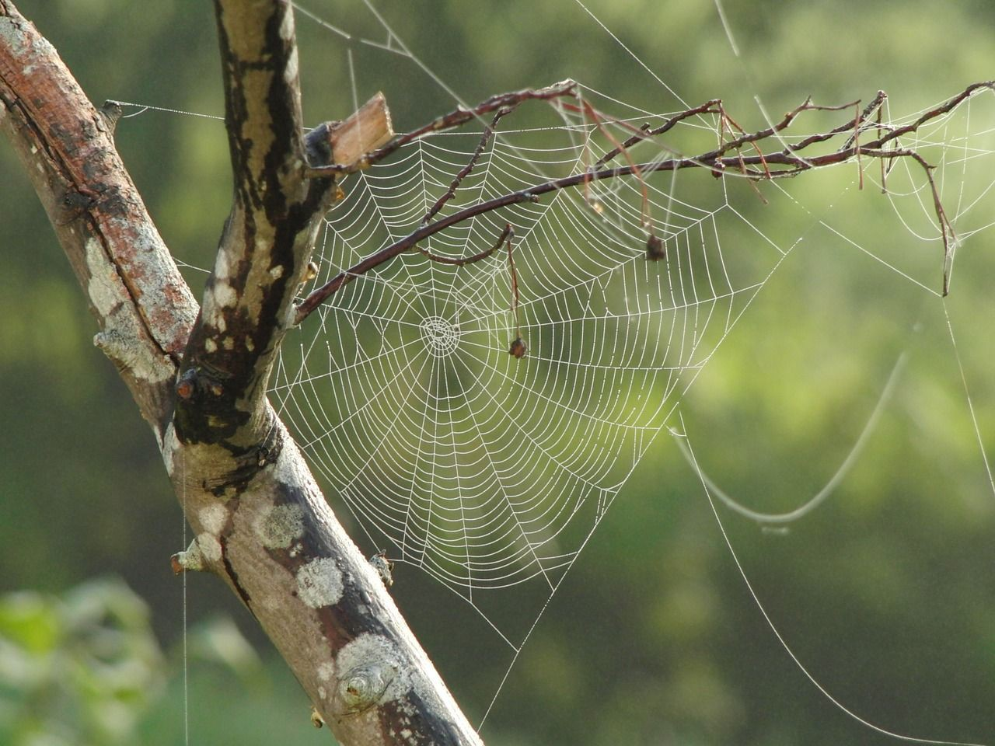



Image Captioning: Failure Cases
Captions generated using neuraltalk2 All images are CC0 Public domain: fur coat, handstand, spider web, baseball
A bird is perched on a tree branch
A woman is holding a cat in her hand
A man in a baseball uniform throwing a ball
A woman standing on a beach holding a surfboard
A person holding a computer mouse on a desk

Slide 77
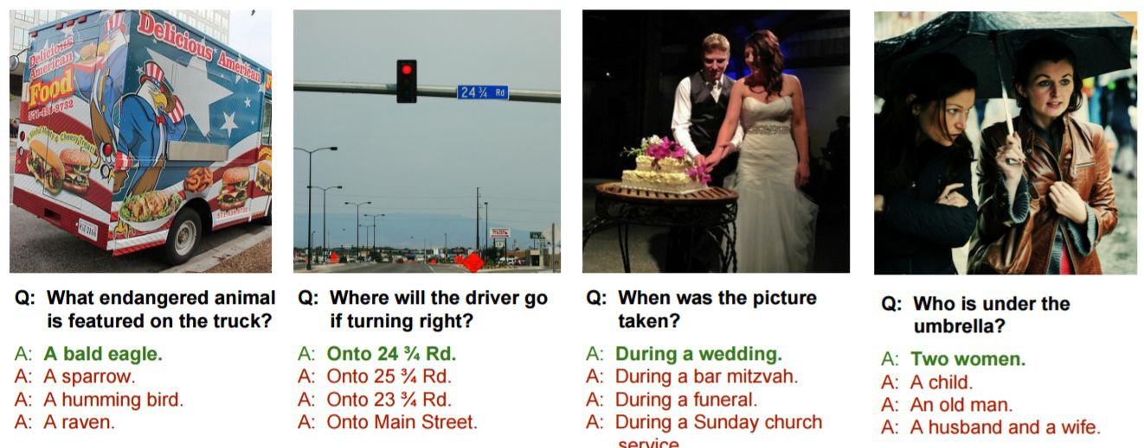
Visual Question Answering (VQA)
Agrawal et al, “VQA: Visual Question Answering”, ICCV 2015
Zhu et al, “Visual 7W: Grounded Question Answering in Images”, CVPR 2016
Figure from Zhu et al, copyright IEEE 2016. Reproduced for educational purposes.

Slide 78
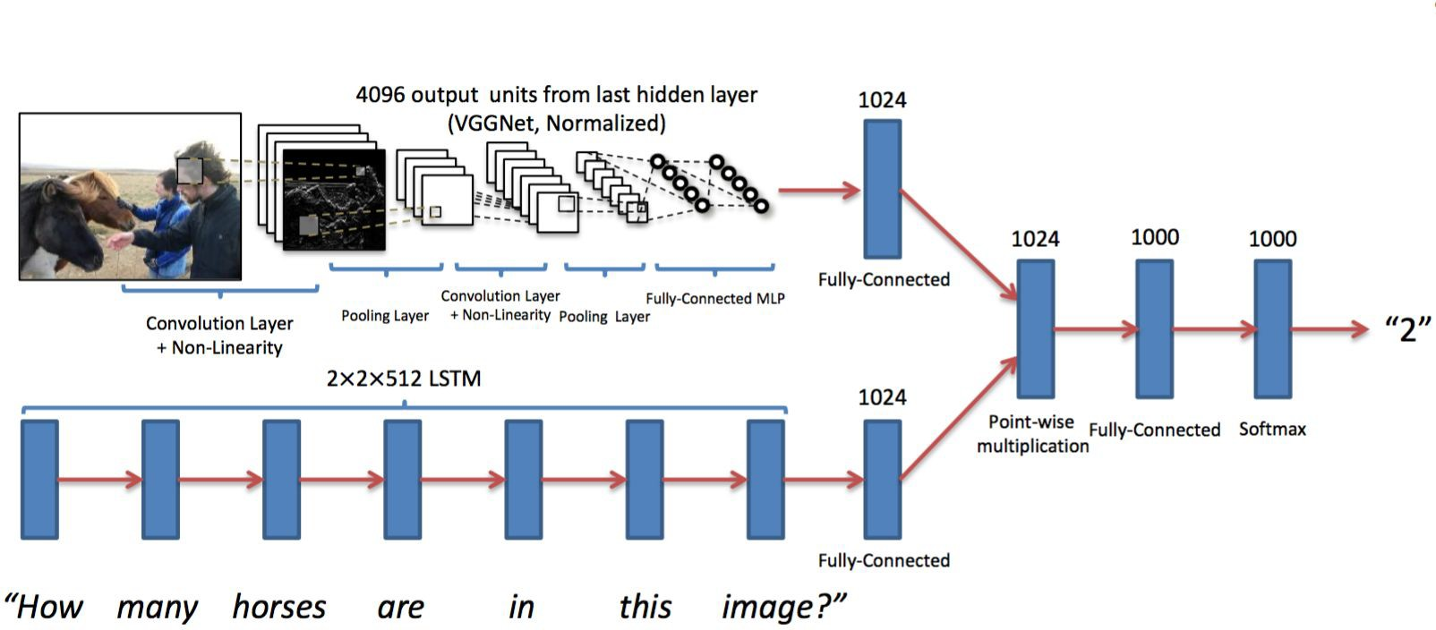
Visual Question Answering (VQA)
Agrawal et al, “Visual 7W: Grounded Question Answering in Images”, CVPR 2015
Figures from Agrawal et al, copyright IEEE 2015. Reproduced for educational purposes.

Slide 79
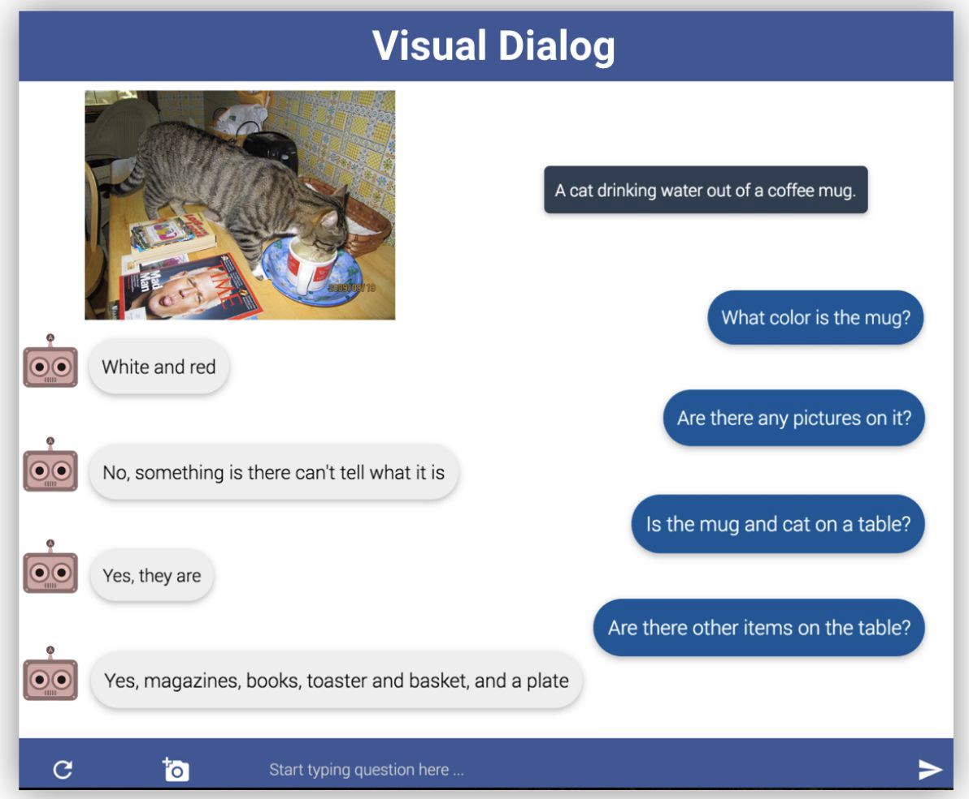
Visual Dialog: Conversations about images
Das et al, “Visual Dialog”, CVPR 2017
Figures from Das et al, copyright IEEE 2017. Reproduced with permission.

Slide 80
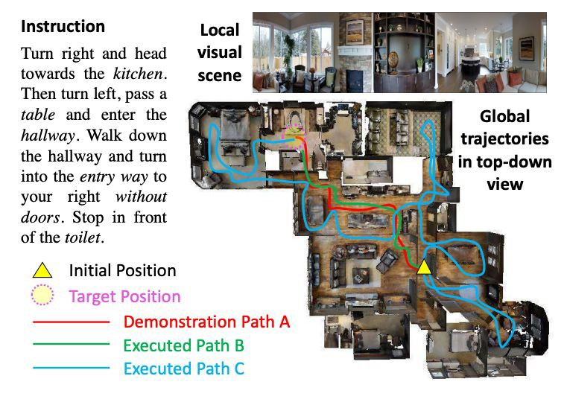
Visual Language Navigation: Go to the living room
Agent encodes instructions in language and uses an RNN to generate a series of movements as the visual input changes after each move.
Wang et al, “Reinforced Cross-Modal Matching and Self-Supervised Imitation Learning for Vision-Language Navigation”, CVPR 2018
Figures from Wang et al, copyright IEEE 2017. Reproduced with permission.

Slide 81
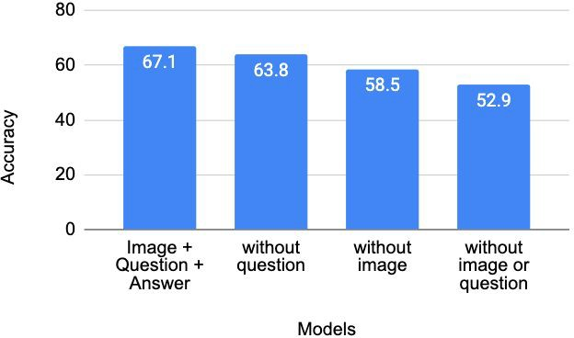
Visual Question Answering: Dataset Bias
All images are CC0 Public domain: dog,
Image
Model
What is the dog playing with?
Question
Yes or No
Frisbee
Answer
Jabri et al. “Revisiting Visual Question Answering Baselines” ECCV 2016

Slide 82
Multilayer RNNs
depth
time

Slide 83
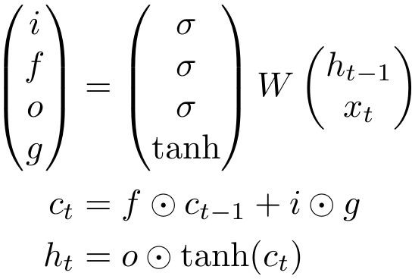

Long Short Term Memory (LSTM)
Vanilla RNN LSTM
Hochreiter and Schmidhuber, “Long Short Term Memory”, Neural Computation 1997

Slide 84

Vanilla RNN Gradient Flow
Bengio et al, “Learning long-term dependencies with gradient descent is difficult”, IEEE Transactions on Neural Networks, 1994
Pascanu et al, “On the difficulty of training recurrent neural networks”, ICML 2013
y_{t}
W
tanh
stack
h_{t}
^{h}t-1
x_{t}

Slide 85
Bengio et al, “Learning long-term dependencies with gradient descent is difficult”, IEEE Transactions on Neural Networks, 1994
Pascanu et al, “On the difficulty of training recurrent neural networks”, ICML 2013
Backpropagation from h_{t} to h_{t-1} multiplies by W
y
(actually W
T₎
t
hh
W
tanh
stack
h_{t}
^{h}t-1
x_{t}

Slide 86

Bengio et al, “Learning long-term dependencies with gradient descent is difficult”, IEEE Transactions on Neural Networks, 1994
Pascanu et al, “On the difficulty of training recurrent neural networks”, ICML 2013
Backpropagation from h_{t} to h_{t-1} multiplies by W
y
(actually W
T₎
t
hh
W
tanh
stack
h_{t}
^{h}t-1
x_{t}

Slide 87


Bengio et al, “Learning long-term dependencies with gradient descent is difficult”, IEEE Transactions on Neural Networks, 1994
Pascanu et al, “On the difficulty of training recurrent neural networks”,
ICML 2013
y₃ y₄
y₁
y₂
h₀
h₁
h₂
h₃
h₄
x₁
x₂
x₃
x₄

Slide 88


Bengio et al, “Learning long-term dependencies with gradient descent is difficult”, IEEE Transactions on Neural Networks, 1994
Pascanu et al, “On the difficulty of training recurrent neural networks”,
ICML 2013
y₃ y₄
Gradients over multiple time steps:
y₁ y₂
h₀
h₁
h₂
h₃
h₄
x₁
x₂
x₃
x₄

Slide 89

Bengio et al, “Learning long-term dependencies with gradient descent is difficult”, IEEE Transactions on Neural Networks, 1994
Pascanu et al, “On the difficulty of training recurrent neural networks”,
ICML 2013
y₃ y₄
Gradients over multiple time steps:
y₁ y₂
h₀
h₁
h₂
h₃
h₄
x₁
x₂
x₃
x₄

Slide 90

Bengio et al, “Learning long-term dependencies with gradient descent is difficult”, IEEE Transactions on Neural Networks, 1994
Pascanu et al, “On the difficulty of training recurrent neural networks”,
ICML 2013
y₃ y₄
Gradients over multiple time steps:
y₁ y₂
h₀
h₁
h₂
h₃
h₄
x₁
x₂
x₃
x₄

Slide 91
Bengio et al, “Learning long-term dependencies with gradient descent is difficult”, IEEE Transactions on Neural Networks, 1994
Pascanu et al, “On the difficulty of training recurrent neural networks”,
ICML 2013
y₃ y₄
Gradients over multiple time steps:
y₁ y₂
h₀
h₁
h₂
h₃
h₄
x₁
x₂ x₃
Almost always < 1
Vanishing gradients
x₄

Slide 92
Bengio et al, “Learning long-term dependencies with gradient descent is difficult”, IEEE Transactions on Neural Networks, 1994
Pascanu et al, “On the difficulty of training recurrent neural networks”,
ICML 2013
y₃ y₄
Gradients over multiple time steps:
y₁ y₂
h₀
h₁
h₂
h₃
h₄
x₁
x₂
x₃
x₄
What if we assumed no non-linearity?

Slide 93

Bengio et al, “Learning long-term dependencies with gradient descent is difficult”, IEEE Transactions on Neural Networks, 1994
Pascanu et al, “On the difficulty of training recurrent neural networks”,
ICML 2013
y₃ y₄
Gradients over multiple time steps:
y₁ y₂
h₀
h₁
h₂
h₃
h₄
x₁
x₂ x₃
What if we assumed no non-linearity?
Largest singular value > 1:
Exploding gradients
x₄
Largest singular value < 1:
Vanishing gradients

Slide 94

Bengio et al, “Learning long-term dependencies with gradient descent is difficult”, IEEE Transactions on Neural Networks, 1994
Pascanu et al, “On the difficulty of training recurrent neural networks”,
ICML 2013
y₃ y₄
Gradients over multiple time steps:
y₁ y₂
h₀
h₁
h₂
h₃
h₄
x₁
x₂ x₃
What if we assumed no non-linearity?
x₄
Largest singular value > 1:
Exploding gradients
Gradient clipping: Scale gradient if its norm is too big
Largest singular value < 1:
Vanishing gradients

Slide 95
Bengio et al, “Learning long-term dependencies with gradient descent is difficult”, IEEE Transactions on Neural Networks, 1994
Pascanu et al, “On the difficulty of training recurrent neural networks”,
ICML 2013
y₃ y₄
Gradients over multiple time steps:
y₁ y₂
h₀
h₁
h₂
h₃
h₄
x₁
x₂ x₃
What if we assumed no non-linearity?
Largest singular value > 1:
Exploding gradients
x₄
Largest singular value < 1:
Vanishing gradients
Change RNN architecture

Slide 96
Long Short Term Memory (LSTM)
Vanilla RNN LSTM

Slide 97
Long Short Term Memory (LSTM)
Vanilla RNN LSTM
Four gates
Cell state
Hidden state

Slide 98
Long Short Term Memory (LSTM)
[Hochreiter et al., 1997]
vector from below (x)
W
x
sigmoid
i
h
sigmoid
f
vector from before (h)
sigmoid
o
tanh
g
4h x 2h
4h
4*h

Slide 99
Long Short Term Memory (LSTM)
[Hochreiter et al., 1997]
vector from below (x)
g: Gate gate (?), How much to write to cell
W
x
sigmoid
i
h
sigmoid
f
vector from before (h)
sigmoid
o
tanh
g
4h x 2h
4h
4*h

Slide 100
i: Input gate, whether to write to cell
vector from below (x)
g: Gate gate (?), How much to write to cell
W
x
sigmoid
i
h
sigmoid
f
vector from before (h)
sigmoid
o
tanh
g
4h x 2h
4h
4*h

Slide 101
i: Input gate, whether to write to cell
f: Forget gate, Whether to erase cell
vector from below (x)
g: Gate gate (?), How much to write to cell
W
x
sigmoid
i
h
sigmoid
f
vector from before (h)
sigmoid
o
tanh
g
4h x 2h
4h
4*h

Slide 102
i: Input gate, whether to write to cell
f: Forget gate, Whether to erase cell
o: Output gate, How much to reveal cell
vector from below (x)
g: Gate gate (?), How much to write to cell
W
x
sigmoid
i
h
sigmoid
f
vector from before (h)
sigmoid
o
tanh
g
4h x 2h
4h
4*h

Slide 103
☉
+
c_{t}
^{c}t-1
f i g
W
☉
tanh
^{h}t-1
stack
o
☉
h_{t}

Slide 104
[Hochreiter et al., 1997]
Backpropagation from c_{t} to
c_{t-1} only elementwise multiplication by f, no matrix multiply by W
c
☉ +
c
t-1
t
f i g
W
☉
tanh
^{h}t-1
stack
o
☉
h_{t}

Slide 105

[Hochreiter et al., 1997]
Uninterrupted gradient flow!
c₀ c₁ c₂
c₃
Notice that the gradient contains the f gate’s vector of activations
allows better control of gradients values, using suitable parameter updates of the forget gate.
Also notice that are added through the f, i, g, and o gates
better balancing of gradient values

Slide 106
Do LSTMs solve the vanishing gradient problem?
The LSTM architecture makes it easier for the RNN to preserve information over many timesteps
e.g. if the f = 1 and the i = 0, then the information of that cell is preserved indefinitely.
By contrast, it’s harder for vanilla RNN to learn a recurrent weight matrix Wh that preserves info in hidden state
LSTM doesn’t guarantee that there is no vanishing/exploding gradient, but it does provide an easier way for the model to learn long-distance dependencies

Slide 107
[Hochreiter et al., 1997]
Uninterrupted gradient flow!
c₀ c₁ c₂
c₃
Similar to ResNet!
3x3 conv, 128
3x3 conv, 128
3x3 conv, 128
3x3 conv, 128
3x3 conv, 128
3x3 conv, 128 / 2
3x3 conv, 64
3x3 conv, 64
3x3 conv, 64
3x3 conv, 64
3x3 conv, 64
3x3 conv, 64
Pool
7x7 conv, 64 / 2 Input
Softmax FC 1000
Pool
3x3 conv, 64
3x3 conv, 64
3x3 conv, 64
3x3 conv, 64
3x3 conv, 64
3x3 conv, 64
...

Slide 108

[Hochreiter et al., 1997]
Uninterrupted gradient flow!
c₀ c₁ c₂
c₃
In between:
Highway Networks
Similar to ResNet!
3x3 conv, 128
3x3 conv, 128
3x3 conv, 128
3x3 conv, 128
3x3 conv, 128
3x3 conv, 128 / 2
3x3 conv, 64
3x3 conv, 64
3x3 conv, 64
3x3 conv, 64
3x3 conv, 64
3x3 conv, 64
Pool
7x7 conv, 64 / 2 Input
Softmax FC 1000
Pool
3x3 conv, 64
3x3 conv, 64
3x3 conv, 64
3x3 conv, 64
3x3 conv, 64
3x3 conv, 64
...

Slide 109


Other RNN Variants
[An Empirical Exploration of Recurrent Network Architectures, Jozefowicz et al., 2015]
GRU [Learning phrase representations using rnn encoder-decoder for statistical machine translation, Cho et al. 2014]
[LSTM: A Search Space Odyssey, Greff et al., 2015]

Slide 110

Neural Architecture Search for RNN architectures
LSTM cell
Cell they found
Zoph et Le, “Neural Architecture Search with Reinforcement Learning”, ICLR 2017
Figures copyright Zoph et al, 2017. Reproduced with permission.

Slide 111
Summary
RNNs allow a lot of flexibility in architecture design
Vanilla RNNs are simple but don’t work very well
Common to use LSTM or GRU: their additive interactions improve gradient flow
Backward flow of gradients in RNN can explode or vanish. Exploding is controlled with gradient clipping. Vanishing is controlled with additive interactions (LSTM)
Better/simpler architectures are a hot topic of current research, as well as new paradigms for reasoning over sequences
Better understanding (both theoretical and empirical) is needed.

